Slide 1
Repurposing of existing vaccines from an epidemiological perspective: What do we know and where are we heading
Christine Stabell Benn, MD, PhD, DMSc, MAE, Professor
Bandim Health Project and Danish Institute for Advanced Study,
University of Southern Denmark
cbenn@health.sdu.dk
Twitter handle: @StabellBenn

Slide 2
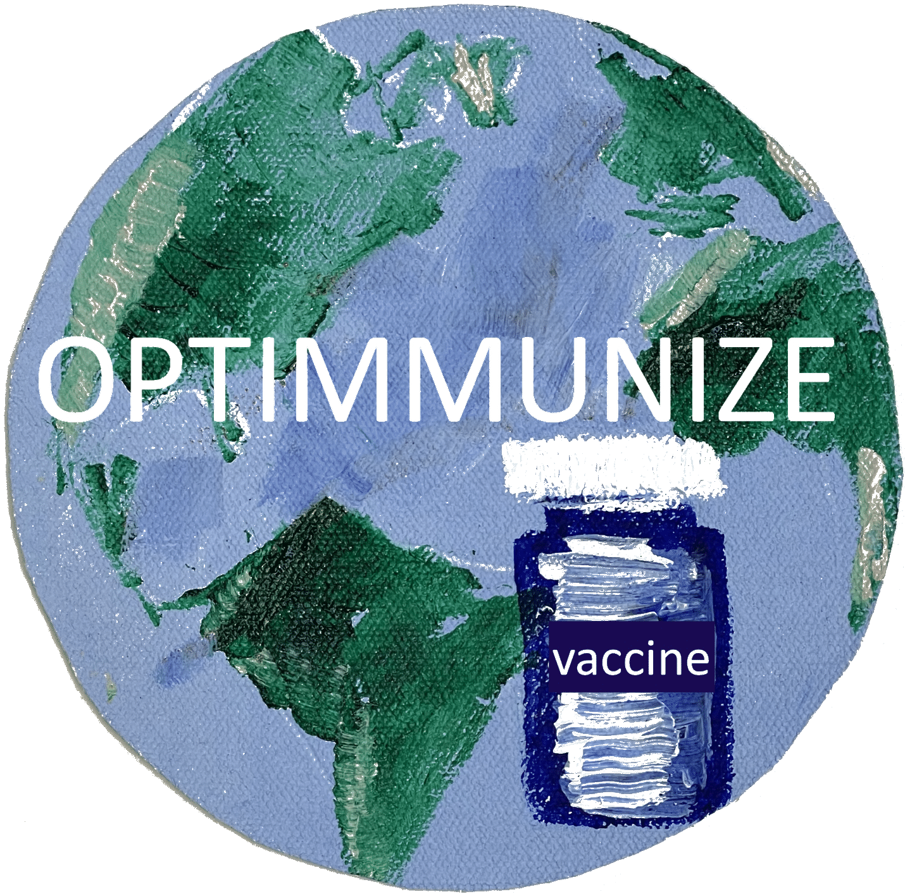
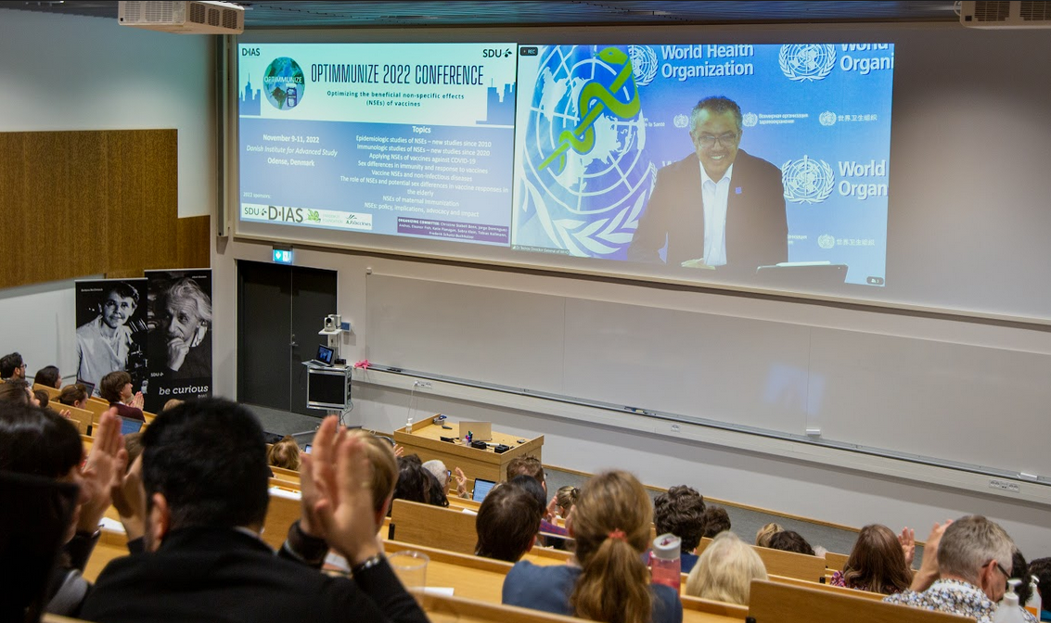
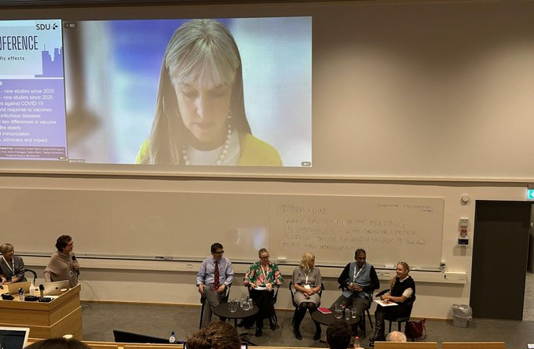
Optimmunize 2022 conference, 9-11 Nov 2022
Panel discussion:Can we start using vaccines for their non-specific effects now? If not, which studies are needed?
“…we will need new and better vaccines for diseases against which there are none, or that offer limited protection.
But we also need to examine how we can use the tried and tested tools we have in new ways, including for their “off target” effects.”

Slide 3
Fruits on the ground
BCG against neonatal mortality

Slide 4
BCG-Denmark-at-birth associated with 1/3 reduction in neonatal mortality and morbidity

Slide 5
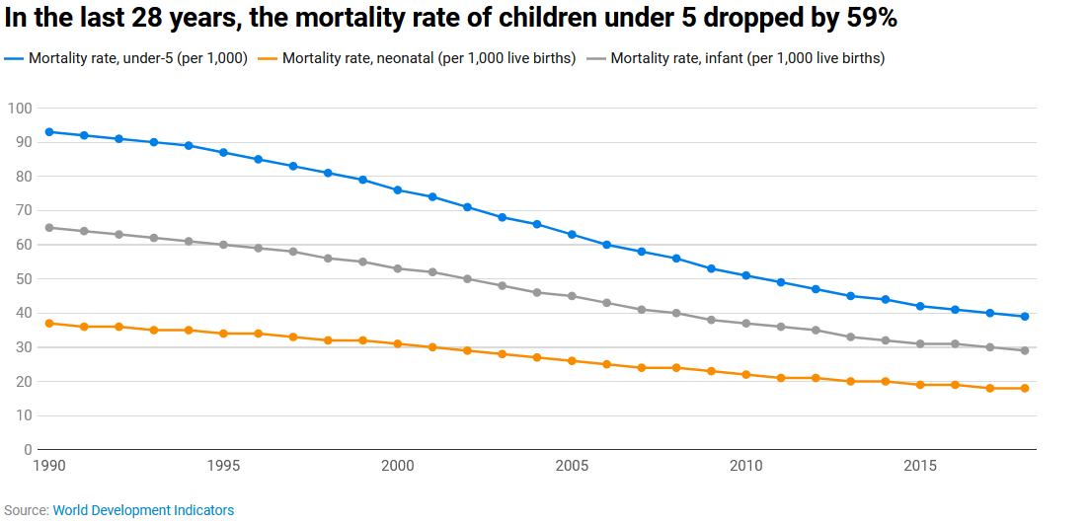
Neonatal mortality remains high – BCG not given at birth

Slide 6
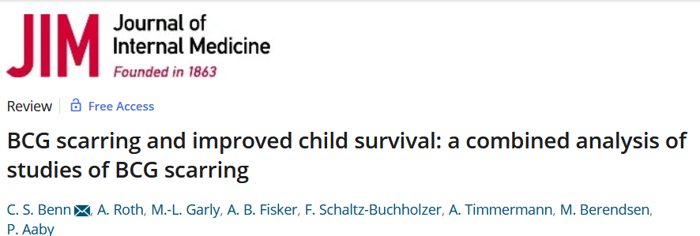
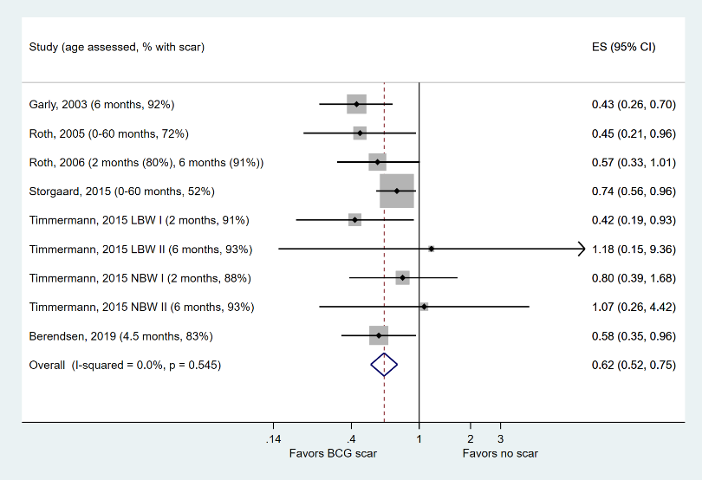
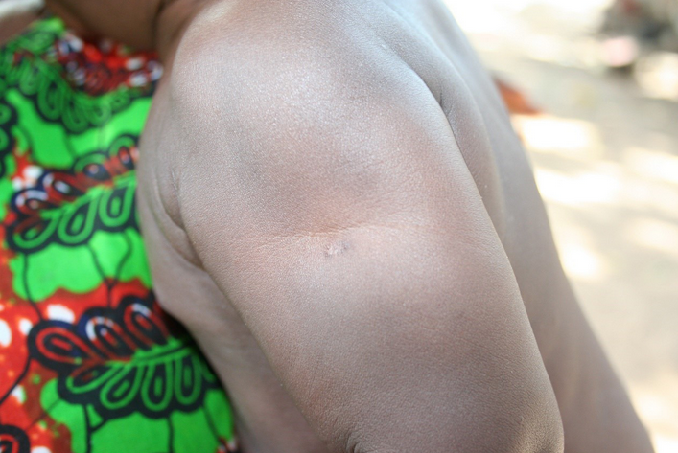
Lower all-cause mortality in BCG-vaccinated children w/ BCG scar than in BCG-vaccinated children wo/ BCG scar

Slide 7
BCG – suggested policy changes at WHO level
Recommend BCG as a vaccine against neonatal mortality
Vaccine program performance indicators (in addition to coverage by 12 months of age):
Coverage by 7 days of life as a performance indicator
Proportion of BCG-vaccinated children with a BCG scar at the time of DTP3
Accompanied by introduction of quality indicators for WHO-prequalified BCG vaccines, since considerable variation between BCG formulations with respect to
the bacteria content, the amount of viable bacteria, the scar frequency and TB protection as well as the non-specific effects

Slide 8
Low-hanging fruits
RCTs likely to reveal huge potential for reducing all-cause mortality:
BCG revaccination of scar-negative children
A “live-vaccine-last” vaccination schedule
OPV/nOPV campaigns
BCG against respiratory infections in the elderly
Live vaccines as bridge-gap-vaccines in pandemics

Slide 9
BCG-revaccination of scar-negative children
BCG-revaccination of scar-negative children used to be policy
Now: not recommended since there is no evidence for improved TB protection
Proposed RCT: Revaccination vs. no revaccination of scar-negative children, with overall mortality as outcome
Based on existing data: will show that BCG revaccination reduces all-cause mortality by ~1/3

Slide 10
A childhood vaccination schedule that emphasizes “live-vaccine-last”
Based on the estimates in the WHO review: A revised schedule, using the same vaccines in a different manner, could prevent 1 mill child deaths/year (Shann, Clin Infect Dis 2020)
Proposed RCT: BCG2 vs. placebo with DTP3, follow-up to 9 months. In countries that use DTP-bosster at 18 months: DTP-booster vs. no DTP-booster.
Based on existing data: will show that the revised schedule reduces all-cause mortality by ~50%

Slide 11
OPV/nOPV campaigns to lower all-cause child mortality
OPV campaigns have been major drivers of the decline in child mortality over the last decades. This decline may be halted, and mortality might increase again, once OPV is phased out.

Slide 12
OPV/nOPV campaigns to lower all-cause child mortality
OPV campaigns have been major drivers of the decline in child mortality over the last decades. This decline may be halted, and mortality might increase again, once OPV is phased out.
nOPV may have similar non-specific effects.
Proposed RCT: nOPV vs OPV vs placebo
Expectations: both OPV and nOPV associated with ~15-20% reduction in all-cause mortality

Slide 13
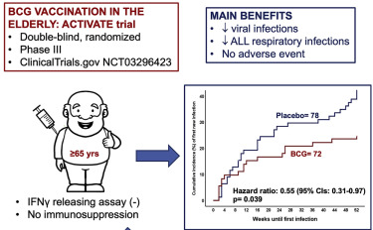
BCG against respiratory infections in the elderly
A booster shot of BCG consistently associated with lower risk of respiratory infections, including COVID-19, in the elderly in small RCTs from Greece, US and India, Indonesia and Japan.

Slide 14
BCG against respiratory infections in the elderly
A booster shot of BCG consistently associated with lower risk of respiratory infections, including COVID-19, in the elderly in small RCTs from Greece, US and India, Indonesia and Japan.
Proposed RCT: Large-scale multicenter trial to confirm the findings from smaller RCTs
Expectations: BCG associated with at least 25% reduction in risk of respiratory infections

Slide 15
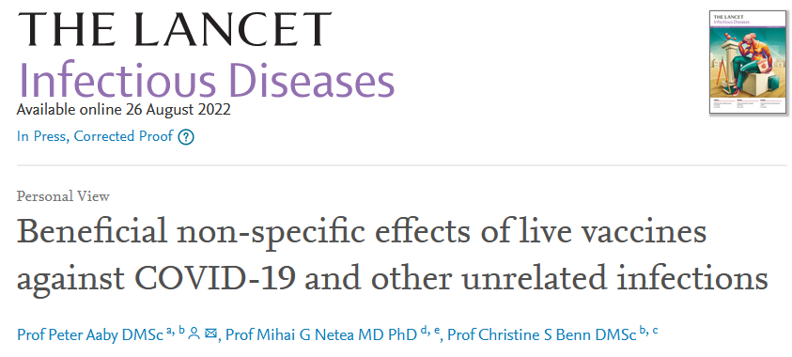
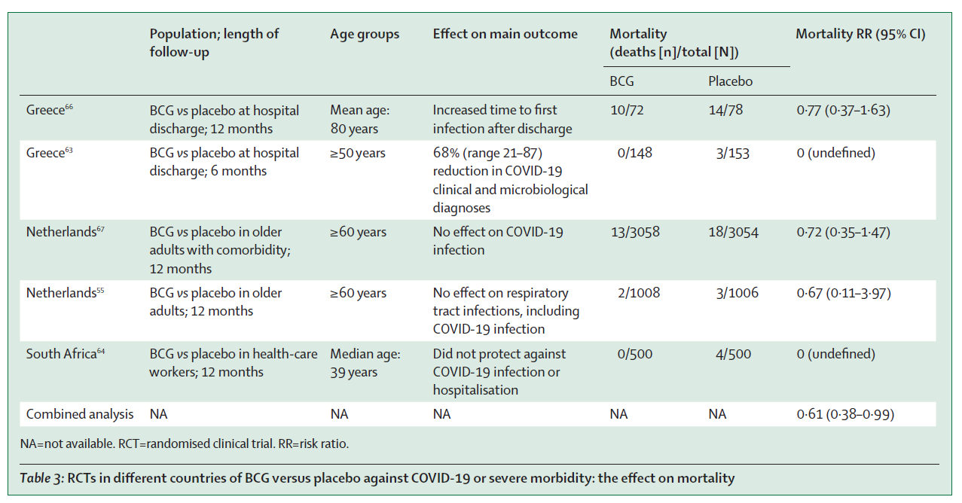
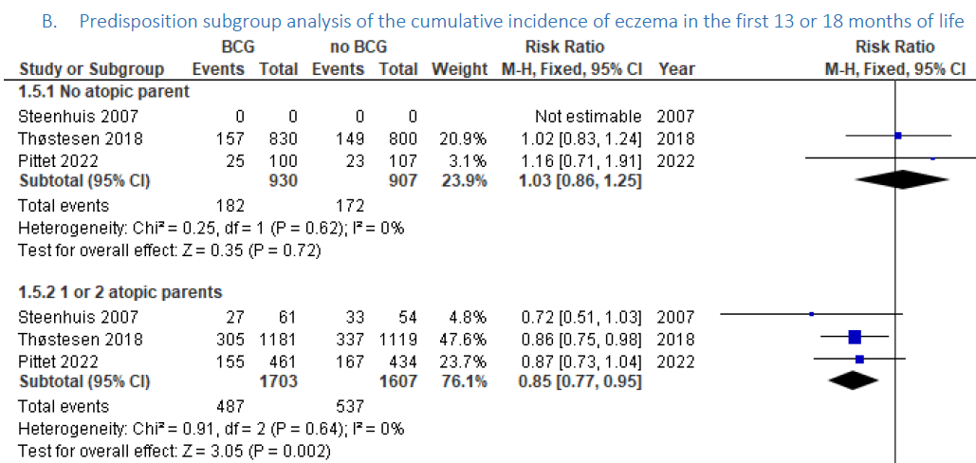
Live vaccines as bridge-gap-vaccines during pandemics
BCG associated with reduced risk of COVID-19 after several doses in highly vulnerable groups – and reduced all-cause mortality across trials.
Interpretation: Effect on severity rather than incidence (and maybe COVID-19 was not the ”right” pathogen).
Some suggestions that there would be stronger effect against influenza.

Slide 16
Live vaccines as bridge-gap-vaccines during pandemics
Proposed RCT: Large-scale multicenter trial testing BCG vs. MMR vs. both vs. placebo during influenza season
Expectations: BCG associated with at least 25% reduction in risk of influenza

Slide 17
Thank you for your attention!
Multiple other areas of exploitation of the immune training effects of live vaccines
RCTs likely to reveal huge potential for reducing all-cause mortality:
BCG revaccination of scar-negative children
A “live-vaccine-last” vaccination schedule
OPV/nOPV campaigns
BCG against respiratory infections in the elderly
Live vaccines as bridge-gap-vaccines in pandemics
BCG against neonatal mortality

Slide 19
Vaccine clinical trials should include
Analysis by sex (not just control for sex)
Analysis by age
Pregnant women
…..

Slide 20
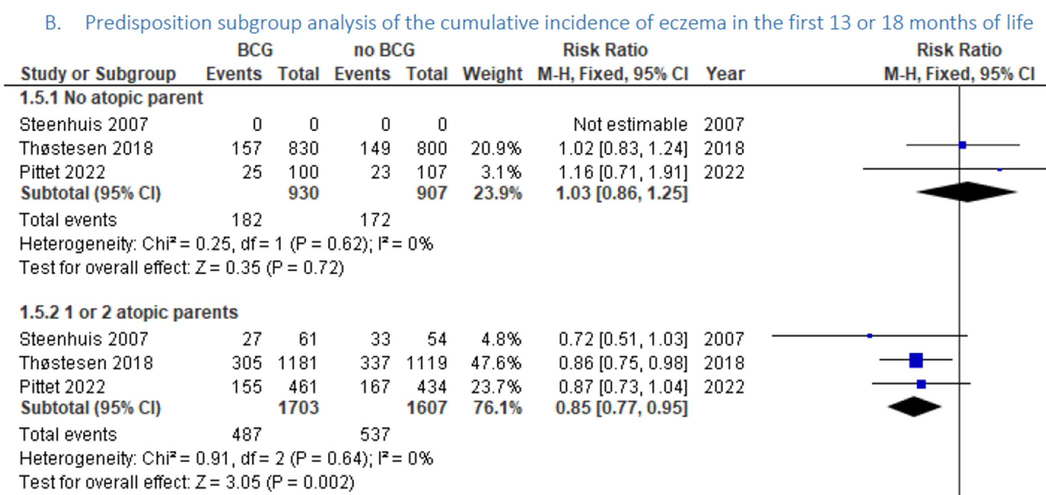
BCG associated with lower risk of atopic dermatitis in predisposed children

